Slide 1
NYC Neighborhood Travel Guide: Covid-19 Risk Comparison
IBM Data science capstone project

Slide 2

Background
New York City (NYC) has one of the highest Covid-19 infection rates
Case numbers has risen exponentially since the beginning of the epidemic back in early March
Though Travel restrictions are in place, many are still traveling and relocating to NYC for various reasons

Slide 3
Project Aim
To provide those who are headed to NYC with information about virus hotspots and places to be in to reduce risk of infection
Targeted Audience:
Travel Agencies
Apartment Rental/Real Estate Agencies
Anyone heading to NYC

Slide 4
Data Description
NYC Department of Health and Mental Hygiene: Covid-19 Data in NYC since February 29th, 2020
NYS Department of Health: Neighborhood definition and corresponding zip codes
New York Geographical Data: Generated from the zip code and neighborhood definition
Foursquare API: Venue types and coordinates

Slide 5
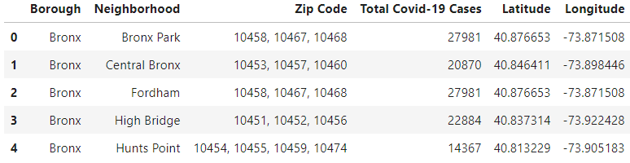
Data Preprocessing
Data was first compiled, cleaned, and reformatted (result shown below)
Data was exported as “compiled_data.csv”

Slide 6
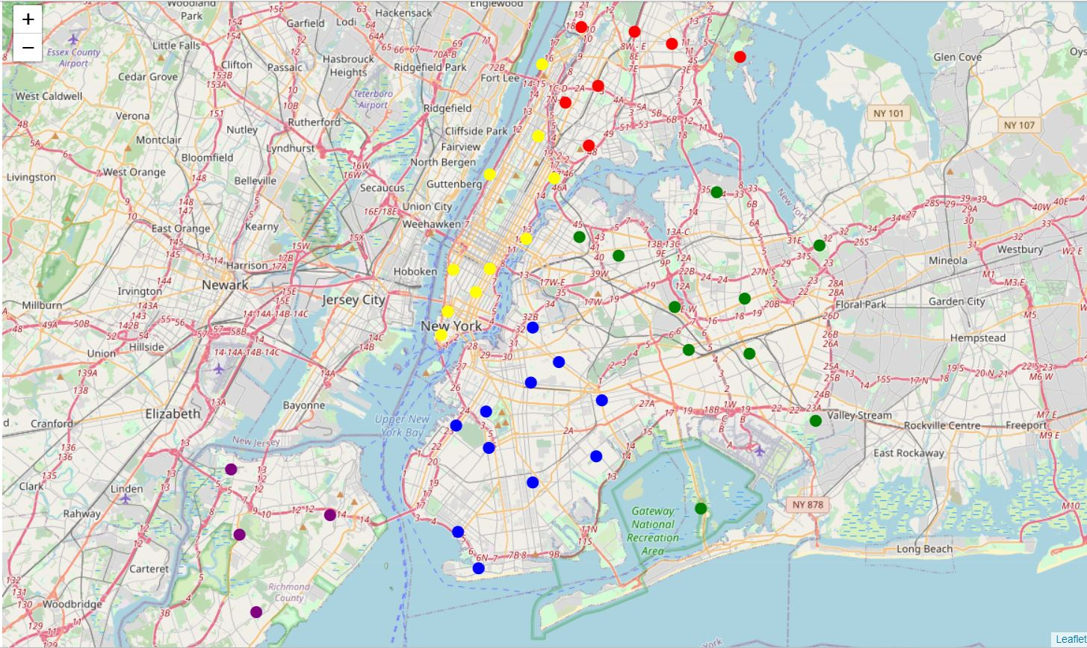
Exploratory Data Analysis

Slide 7
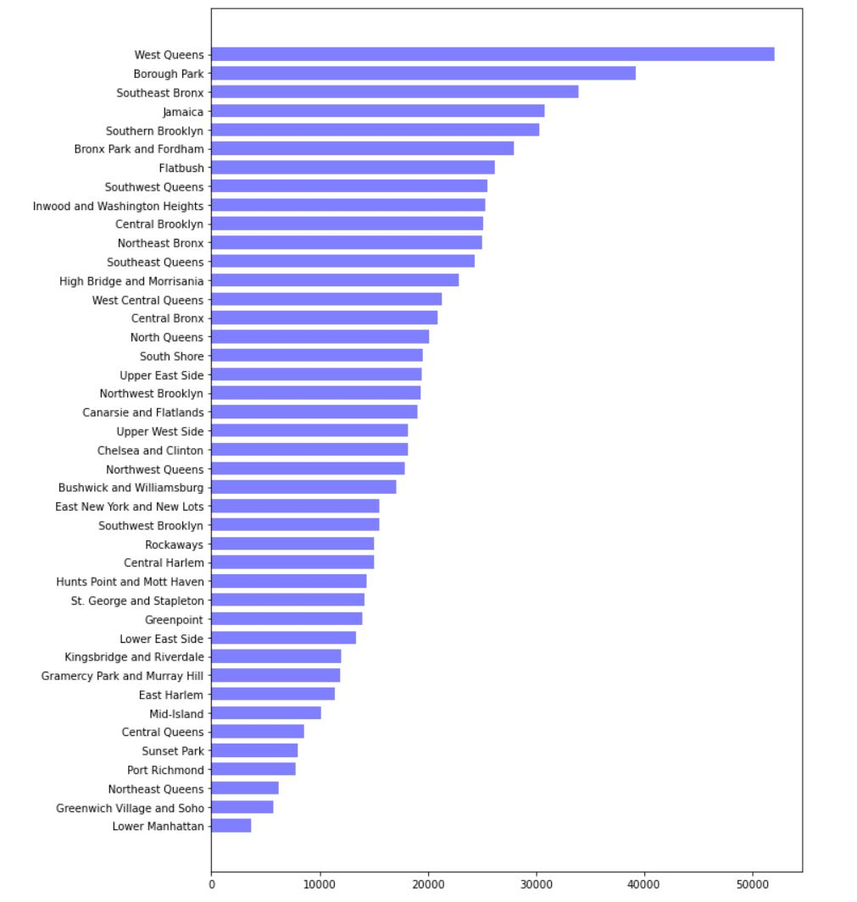
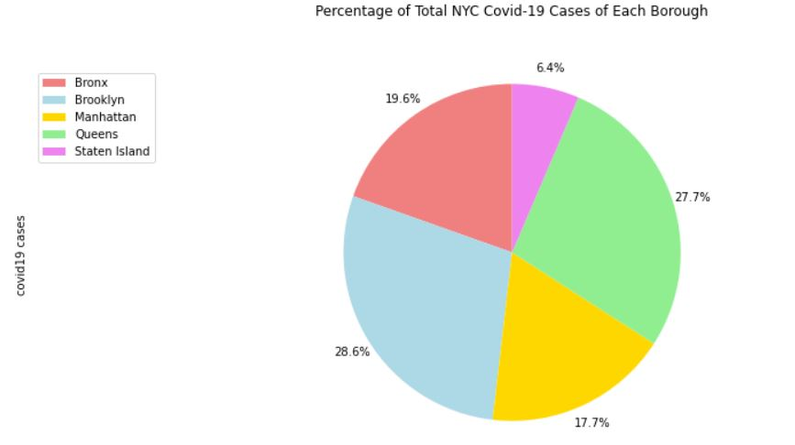
Explroatory Data Analysis (Cont’d)

Slide 8
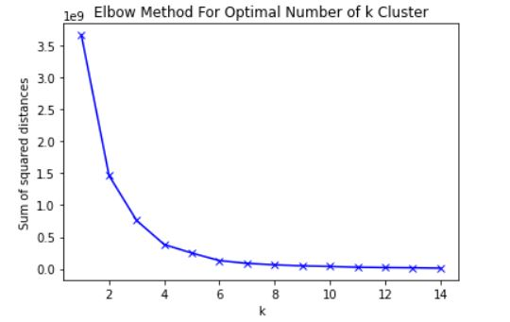
K-Means Clustering
Elbow Method: Used for determining the optimal value of clusters for K-means clustering
Test k – value range: 1 - 15
Optimal k = 4

Slide 9
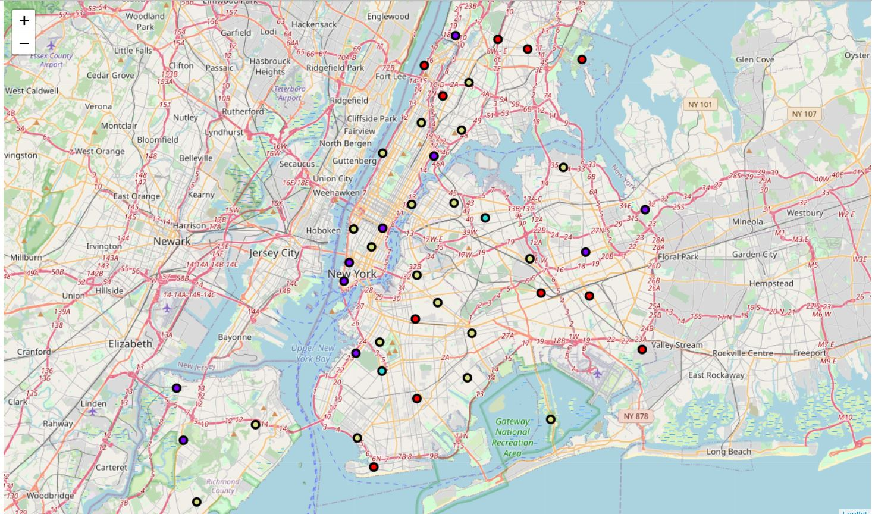
K-Means Clustering Map

Slide 10
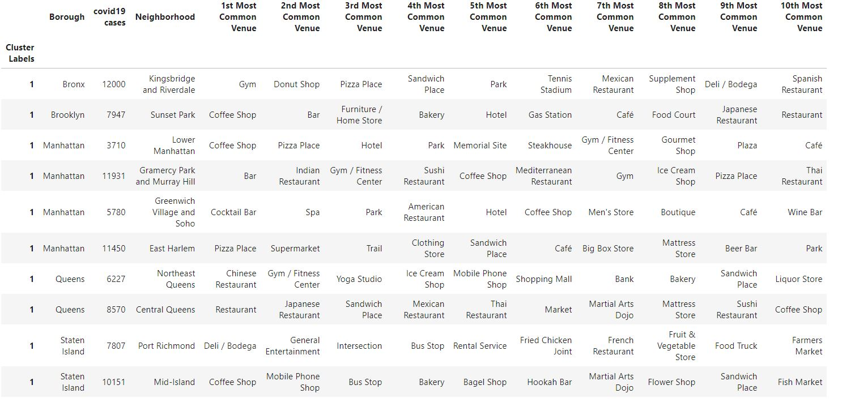
Low Risk Group

Slide 11
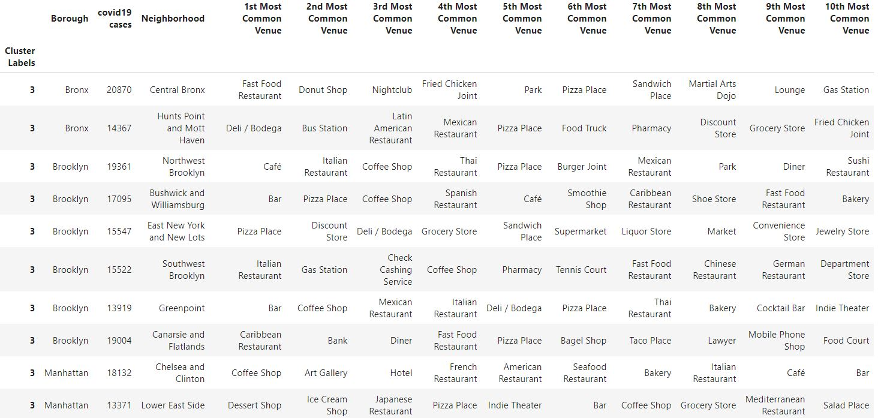
Medium Risk Group

Slide 12
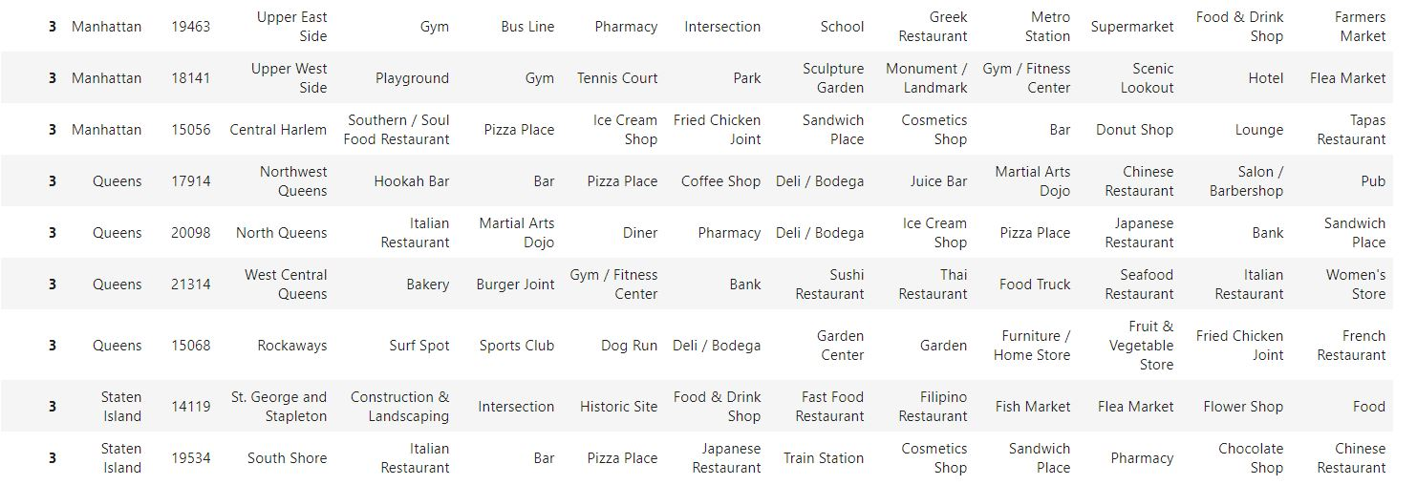
Medium Risk Group (Cont’d)

Slide 13
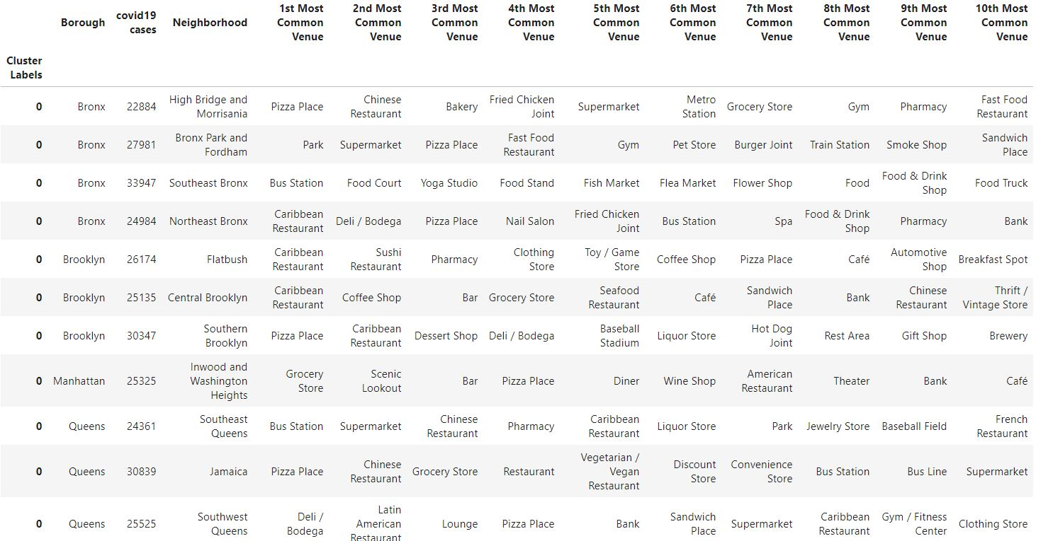
High Risk Group

Slide 14
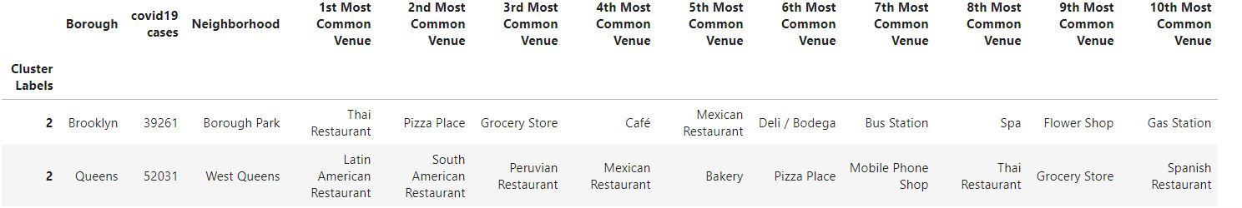
Very High Risk Group

Slide 15
Conclusion
Successfully created groups with similar covid-19 cases along with venue information for each neighborhood
No apparent trend between venue types and covid-19 case number was noted
There are many neighborhoods that are relatively safe to enjoy and be in as long as proper safety measures are followed

